Slide 1
PMG 4101: Project Management
Syed Samin Sadaf
Lecturer
Department of CSE,
United International University (UIU)

Slide 2
Rational Unified Process
(RUP) Methodology

Slide 3
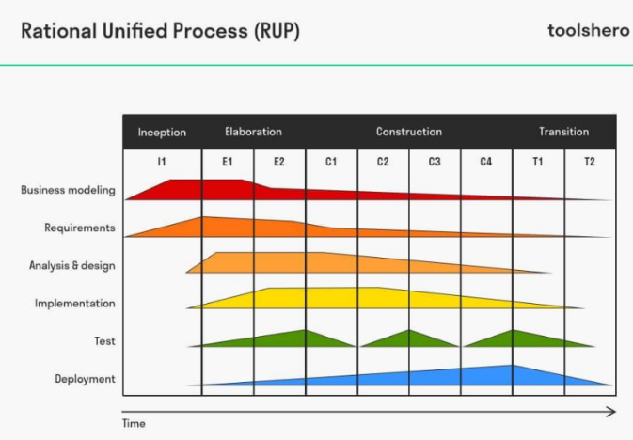
Rational Unified Process (RUP) Methodology
Rational Unified Process (RUP) is an agile software development method, in which the life cycle of a project, or the development of software, is divided into four phases. Various activities take place
during these phases: modelling, analysis and design, implementation, testing and application.

Slide 4
Key Phases of RUP:
Inception: Defines the project scope, core requirements, and feasibility, determining if the project is worth pursuing.
Elaboration: Analyzes the domain, establishes a solid architectural foundation, and mitigates high-risk elements.
Construction: Develops and tests the software components, turning the architecture into a fully functional product.
Transition: Delivers the product to the end-user, covering testing, deployment, and training.

Slide 5
Advantages
✓ It provides good documentation, it completes the process in itself.
✓ It provides risk-management support.
✓ It reuses the components, and hence total time duration is less.
✓ Good online support is available in the form of tutorials and training.

Slide 6
Disadvantages
Team of expert professional is required, as the process is complex.
Complex and not properly organized process.
More dependency on risk management.
Hard to integrate again and again.

Slide 7
When to use RUP
When building a customized software development process suited to a specific organizational environment
When the development process needs to be tailored using gathered project and environmental information
For large and complex software or engineered systems
When incremental and iterative development is preferred
When clear project phases and structured management are required
When the project involves multiple teams or stakeholders
When strong documentation and modeling (e.g., UML) are necessary

Slide 8
When NOT to use RUP
For small or simple projects where a heavy process is unnecessary
When the team requires very lightweight or fast development methods
When project timelines are very short
When the organization lacks experience with structured processes or modeling techniques
When the team prefers highly flexible and informal approaches such as Agile Software Development
When extensive documentation and process overhead are not desirable
For projects with very small teams where complex process frameworks add little value

Slide 9
Prototype Methodology

Slide 10
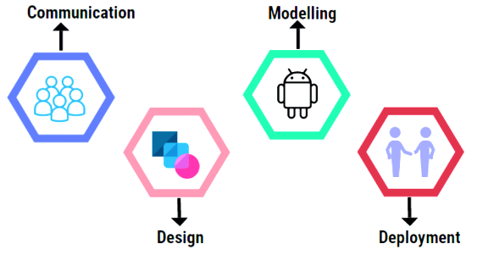
Prototype Methodology
Instead of developing a full-fledged software, the prototype model allows developers to work on the prototype version of the final product. The prototype is then made available for customer testing, evaluation, and feedback.

Slide 11
Prototype Methodology
Based on the gathered feedback, the
prototype goes through several iterations of refinement until it’s deemed satisfactory by the customer.
The appeal of the prototype approach is its rigorous evaluation that uncovers possible issues before actual development begins.

Slide 12
Advantages
✓ Good in ironing out potential issues in the early development stage, which greatly reduces product failure risk.
✓ Ensures the customer is happy with the ‘product’, before real development started.
✓ Build rapport with the customer early on with the discussions, which helps throughout the project.
✓ Gather detailed information with the prototype, which is later on used in building the final version.

Slide 13
Disadvantages
Excessive to and from in testing out the prototype with the customer can delay the development timeline.
The customer’s expectations of the actual product may not align with the prototype.
There’s a risk of cost overrun as the works on the prototype are often paid for by the developer.

Slide 14
When to use Prototype Methodology
When requirements are not clearly understood at the beginning
When user feedback is needed early in development
When the system involves complex user interfaces
When developers need to demonstrate system functionality to stakeholders
When the project involves high user interaction
When exploring new ideas or innovative features
When requirements need validation before full development starts

Slide 15
When NOT to use
When requirements are already clear and stable
When the system is very simple and straightforward
When strict deadlines do not allow time for prototype development
When users may confuse the prototype with the final product
When the project requires strong documentation and strict processes
When the system involves large-scale back-end processing with little user interaction

Slide 16
Scrum Methodology

Slide 17
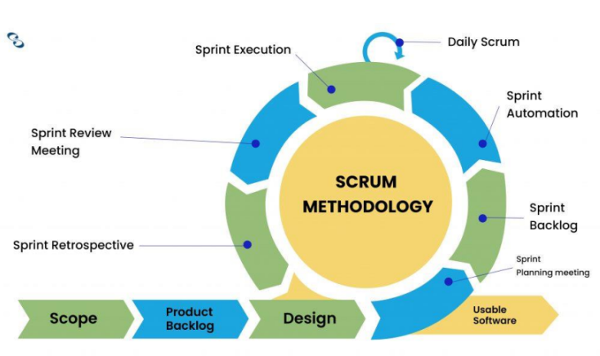
Scrum Methodology
Scrum is arguably one of the most flexible software development methodologies available. It is based on the Agile philosophy and is favored for its incremental and iterative approaches. The Scrum
methodology involves the Product Owner, Scrum Master, and the Development Team.

Slide 18
Scrum Methodology
The product owner takes input from
the client and ensures that the team
is on track in fulfilling the client’s
requirements. Meanwhile, the
Scrum Master acts as a facilitator
and ensures that team members are
familiar with the Scrum process.
The team takes charge of executing
the development.

Slide 19
Scrum Methodology
What makes Scrum an ideal methodology in a fast-paced environment is how tasks are executed in sprints. Each sprint takes up to 4 weeks. The speedy execution allows teams to identify issues, introduce solutions, test, and gather feedback in a short period. It makes tackling fast-paced projects much easier.

Slide 20
Advantages
✓ Short iterations allow quick resolutions to problems.
✓ Scrum is very responsive to changes as the process includes regular feedback.
✓ Scrum is economical and effective.
✓ Regular meetings ensure that team members are on the same page at all times.
✓ Contributions of individual members are noticed and appreciated through the Scrum meetings.

Slide 21
Disadvantages
All team members must be equally skilled and committed for Scrum to work.
The daily Scrum meetings can be draining for team members.
May increase time-to-market if there’s no strict control on the deadline.
Not suitable for large projects.

Slide 22
When to use Scrum
When requirements change frequently
When continuous customer feedback is needed
When the project can be developed incrementally
When the team is small to medium sized (5–10 members)
When regular delivery of working features is important
When team collaboration and communication are strong
When the project benefits from short development cycles (sprints)

Slide 23
When NOT to use Scrum
When requirements are fixed and unlikely to change
When the project requires strict documentation and formal processes
When team members cannot collaborate closely
When the project involves very large teams without proper coordination
When stakeholders are unavailable for frequent feedback
When the work cannot be easily divided into small increments
When the organization prefers predictable, sequential development models such as the Waterfall Model

Slide 24
Any Questions?

Slide 25
Acknowledgement
Slide Courtesy:
Dr. Suman Ahmed, Professor, CSE Department, UIU

Slide 26
Thank You!

